Slide 1
Foundations of Statistics
Antonio Reyes Pérez (PhD)
Facultad de Lenguas y Letras
Universidad Autónoma de Querétaro
Data Processing Workshop
April 2025

Slide 2

Why do we need Statistics?
To measure
To represent
To interpret
To generalize

Slide 3
Two main approaches
Descriptive Statistics
Inferential Statistics

Slide 4
Descriptive Statistics
It describes or summarizes features from a sample
Focus is on quantitative data
Based on measures of central tendency and measures of dispersion or variability

Slide 5
Inferential Statistics
It learns from Descriptive Statistics
Focus is on inferring properties to generalize patterns
Based on Probability Theory

Slide 6

Measures of central tendency
Mean
Mode
Median
*Frequency

Slide 7
Measures of dispersion
Variance
Standard deviation*
How much a datum is deviating from the central tendency?
*By obtaining the squared root, the values are comparable with the central tendency

Slide 8
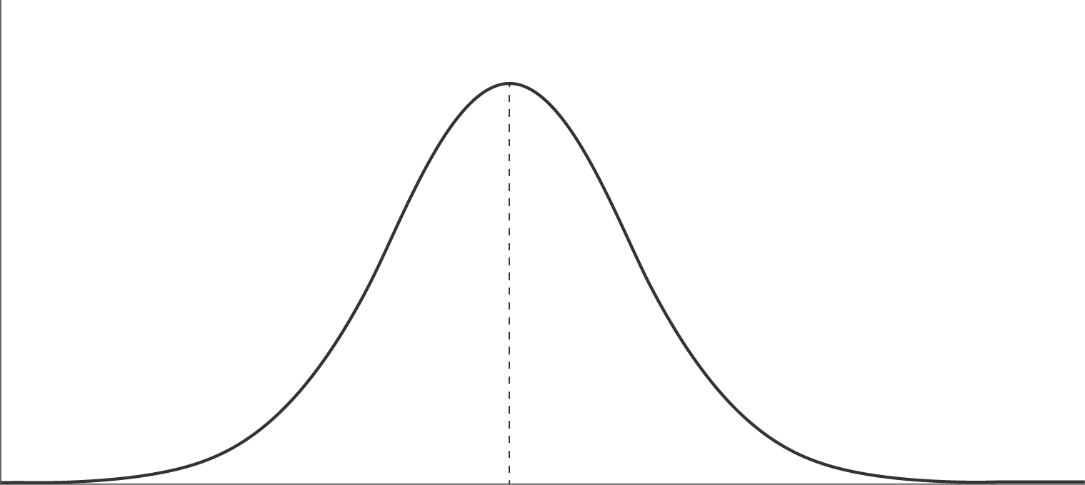
A visual insight
Normal distribution
Central Tendency
Dispersion
Dispersion

Slide 9
Frequency
Number of repetitions of N item
Absolute frequency: number of times an item occurs
Relative frequency: number of time an item occurs divided by the total number of items

Slide 10
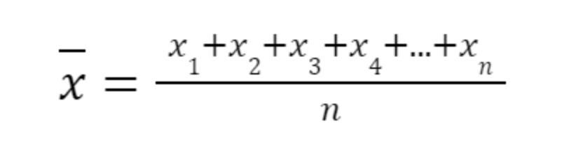
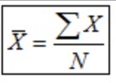
Mean
Average
Sum of the numerical values of each observation, divided by the total number of observations
Influenced by outliers (large or small)

Slide 11
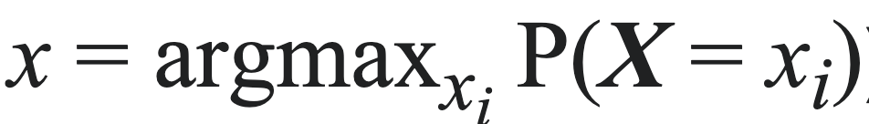
Mode
Value (item) that appears most often in a set of data
Value that is most likely to be sampled
Unimodal, bimodal, trimodal, multimodal

Slide 12
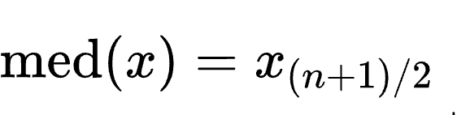
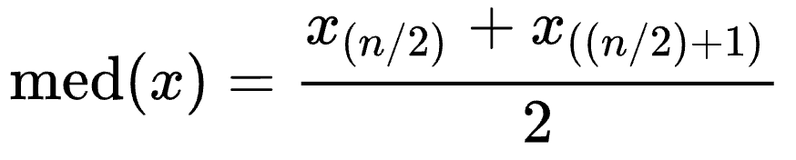
Median
n = odd value
Value between the higher half and the lower half
The middle value (ordered values: smallest to greatest)
Unlike the mean, it is not influenced by outliers
n = even values

